Slide 1
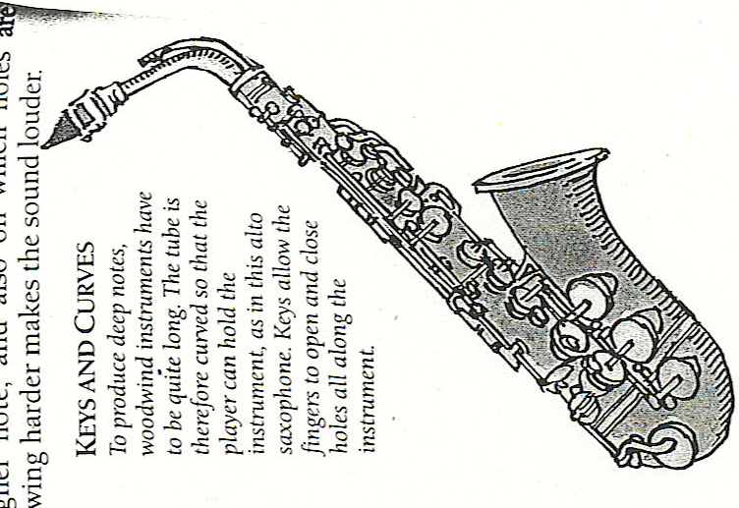
Standing waves in air columns – flute & clarinet same length, why can a much lower note be played on a clarinet?
LECTURE 8 Ch 16
L
Closed at both ends
Closed at one end
open at the other
Open at both ends
Closed end: displacement zero (node), pressure max (antinode)
Open end: displacement max (antinode), pressure zero (node)
CP 516

Slide 2
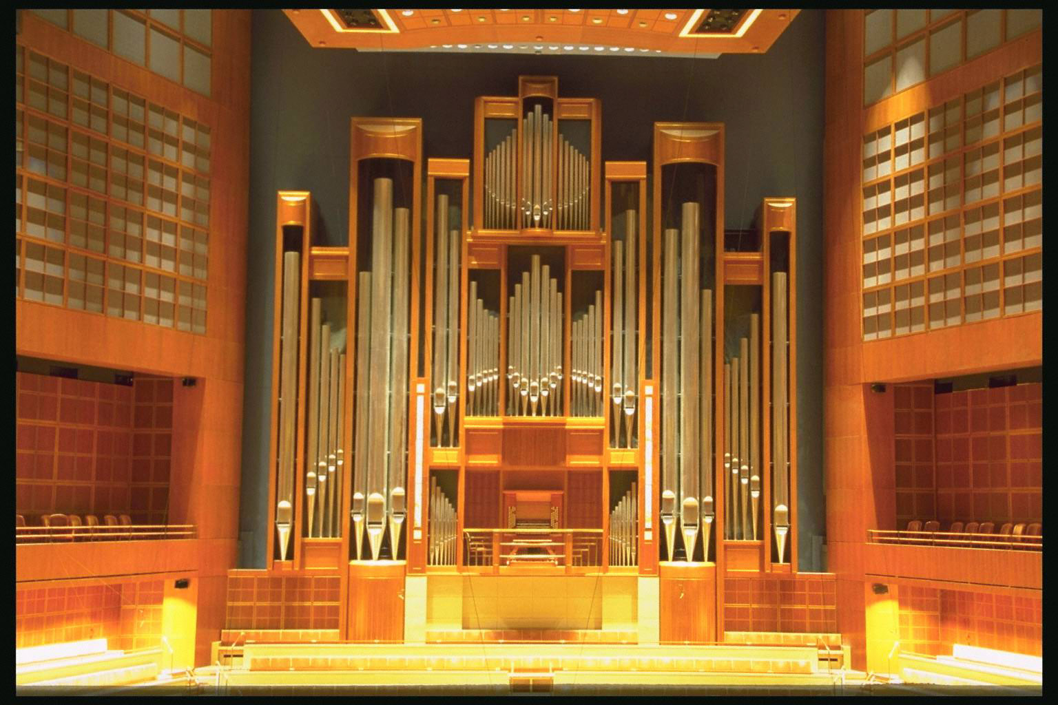
Organ pipes
are open at
both ends

Slide 3
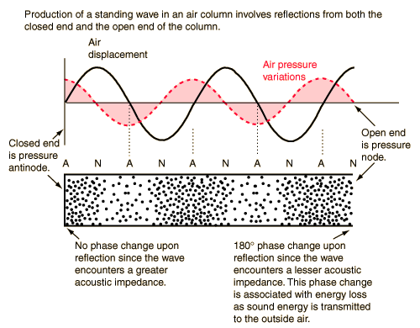
Standing Waves in air column
Sound wave in a pipe with one closed and one open end (stopped pipe)

Slide 4
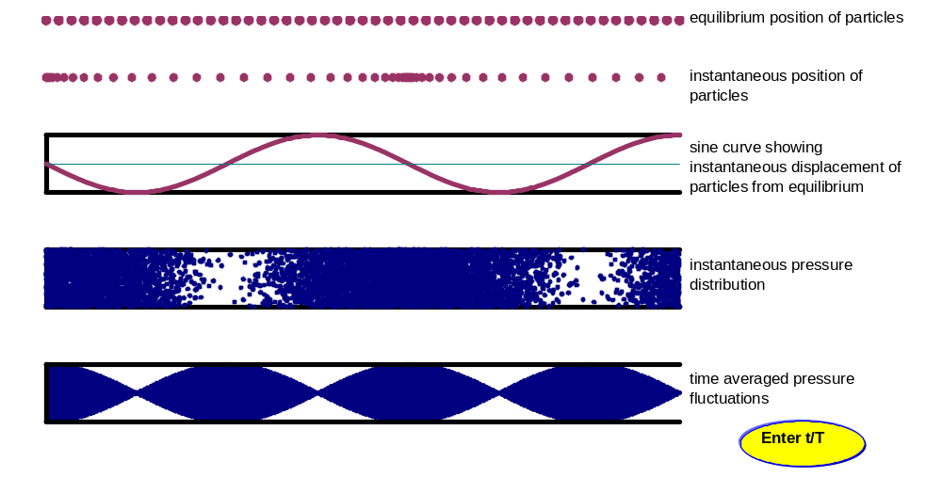
CP 516

Slide 5
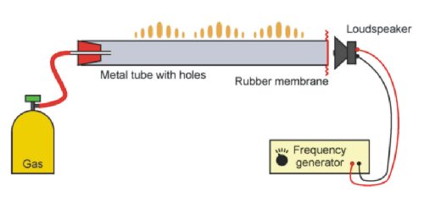
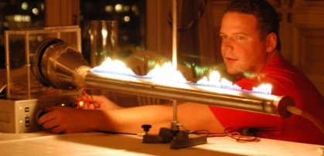
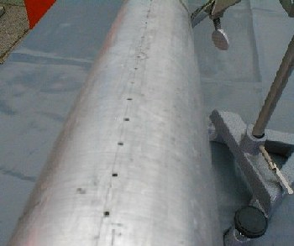
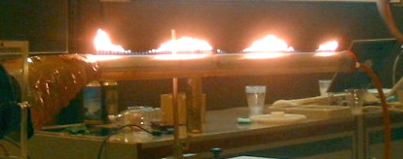
Search google or YouTube for
Rubens or Rubins tube

Slide 6
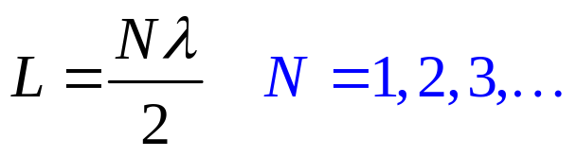
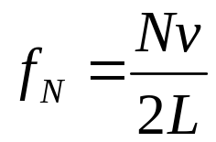
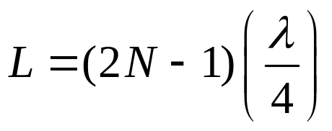
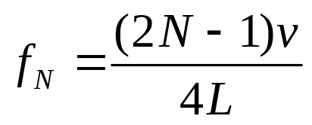
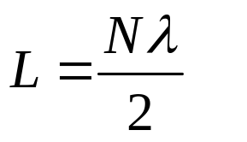
Standing waves in air columns
L
L
CP 516

Slide 7
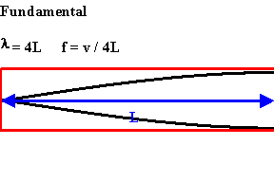
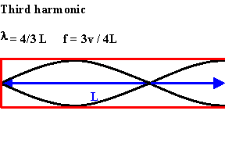
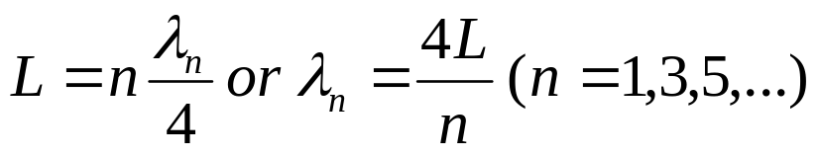
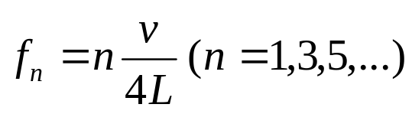
Standing waves in air column
Normal modes in a pipe with an open and a closed end (stopped pipe)

Slide 8
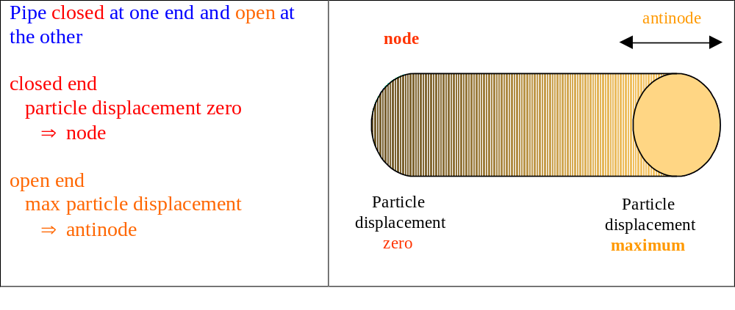
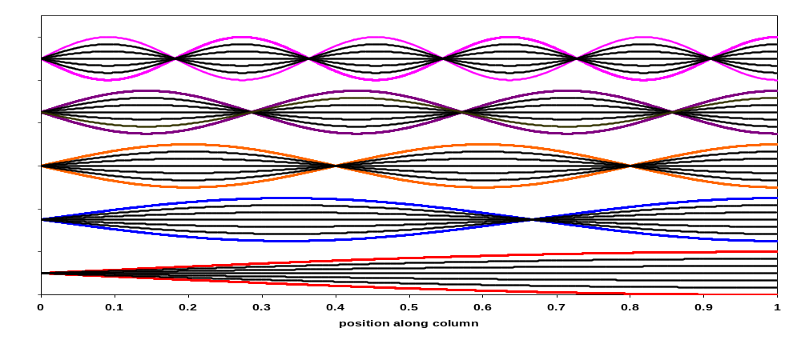
CP 523

Slide 9
Musical instruments – wind
An air stream produced by mouth by blowing the instruments interacts with the air in the pipe to maintain a steady oscillation.
All brass instruments are closed at one end by the mouth of the player.
Flute and piccolo – open at atmosphere and mouth piece (embouchure) – covering holes L ↓ ⇒ λ ↓ ⇒ f ↑
Trumpet – open at atmosphere and closed at mouth – covering holes adds loops of tubing into air stream L ↑ ⇒ λ ↑ ⇒ f ↓
Woodwinds – vibrating reed used to produce oscillation of the air molecules in the pipe.
CP 516

Slide 10
Woodwind instruments are not necessarily made of wood eg saxophone, but they do require wind to make a sound. They basically consist of a tube with a series of holes. Air is blow into the top of the tube, either across a hole or past a flexible reed. This makes the air inside the tube vibrate and give out a note. The pitch of the note depends upon the length of the tube. A shorter tube produces a higher note, and so holes are covered. Blowing harder makes a louder sound. To produce deep notes woodwind instruments have to be quite long and therefore the tube is curved.
Brass instruments (usually made of brass) consist of a long pipe that is usually coiled and has no holes. The player blows into a mouthpiece at one end of the pipe, the vibration of the lips setting the air column vibrating throughout the pipe. The trombone has a section of pipe called a slide that can be moved in and out. To produce a lower note the slide is moved out. The trumpet has three pistons that are pushed down to open extra sections of tubing. Up to six different notes are obtained by using combinations of the three pistons.
CP 516

Slide 11
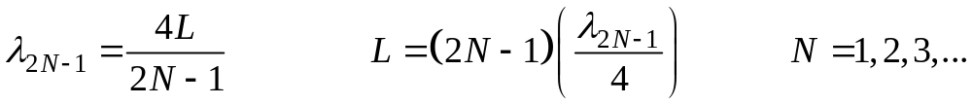
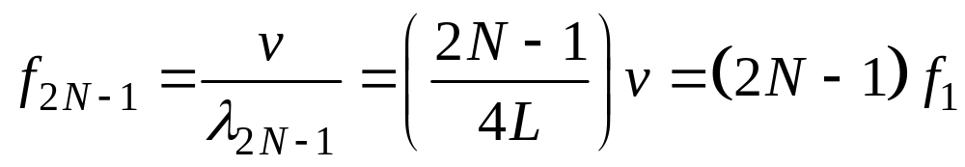
Natural frequencies of vibration (open – closed air column)
Speed of sound in air (at room temperature v ~ 344 m.s⁻¹) v = f λ
Boundary conditions
Reflection of sound wave at ends of air column: Open end – a compression is reflected as a rarefaction and a rarefaction as a compression (π phase shift). Zero phase change at closed end.
odd harmonics exit: f₁, f₃, f₅, f₇ , …
CP 516

Slide 12
Problem 8.1
A narrow glass tube 0.50 m long and sealed at its bottom end is held vertically just below a loudspeaker that is connected to an audio oscillator and amplifier. A tone with a gradually increasing frequency is fed into the tube, and a loud resonance is first observed at 170 Hz. What is the speed of sound in the room?
[Ans: 340 m.s⁻¹]

Slide 13
Problem 8.2
What are the natural frequencies of vibration for a human ear?
Why do sounds ~ (3000 – 4000) Hz appear loudest?
Solution I S E E
Assume the ear acts as pipe open at the atmosphere and closed at the eardrum. The length of the auditory canal is about 25 mm.
Take the speed of sound in air as 340 m.s⁻¹.
L = 25 mm = 0.025 m v = 340 m.s⁻¹
For air column closed at one end and open at the other
L = λ₁ / 4 ⇒ λ₁ = 4 L ⇒ f₁ = v / λ₁ = (340)/{(4)(0.025)} = 3400 Hz
When the ear is excited at a natural frequency of vibration → large amplitude oscillations (resonance) ⇒ sounds will appear loudest ~ (3000 – 4000) Hz.

Slide 14
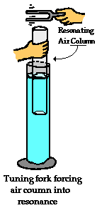
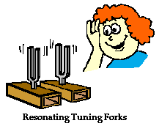
Resonance
When we apply a periodically varying force to a system that can
oscillate, the system is forced to oscillate with a frequency equal
to the frequency of the applied force (driving frequency): forced
oscillation. When the applied frequency is close to a characteristic
frequency of the system, a phenomenon called resonance occurs.
Resonance also occurs when a
periodically varying force is applied
to a system with normal modes.
When the frequency of the applied
force is close to one of normal
modes of the system, resonance
occurs.

Slide 15
Problem 8.3
Why does a tree howl?
The branches of trees vibrate because of the wind.
The vibrations produce the howling sound.
Length of limb L = 2.0 m
Wave speed in wood v = 4.0×10³ m.s⁻¹
Fundamental L = λ / 4 λ = 4 L
v = f λ
f = v / λ = (4.0 ×10³) / {(4)(2)} Hz
f = 500 Hz
N
A
Fundamental mode of vibration

Slide 16
Chimney acts like an organ pipe open at both ends
Pressure node
N
Speed of sound in air v = 340 m.s⁻¹
Length of chimney L = 3.00 m
L = λ / 2 λ = 2 L v = f λ
f = v / λ = 340 / {(2)(3)} Hz
f = 56 Hz low moan
A
Pressure node
N
fundamental mode of vibration

Slide 17
Problem 8.5
Why does a clarinet play a lower note than a flute when both instruments are about the same length ?
A flute is an open-open tube.
A clarinet is open at one end and closed at the other end by the player’s lips and reed.
open
open
closed
open

Slide 18
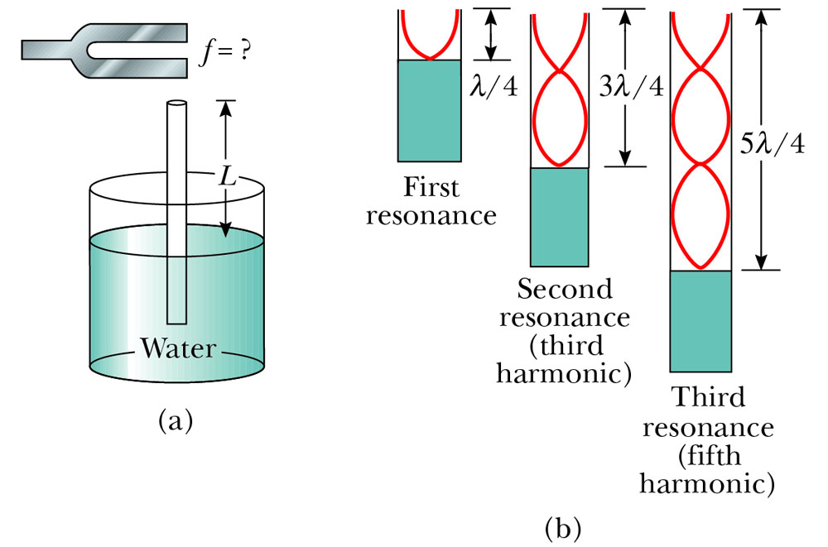
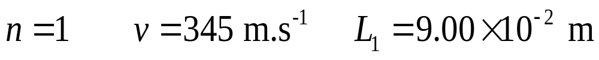
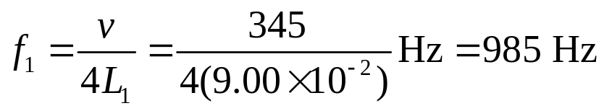

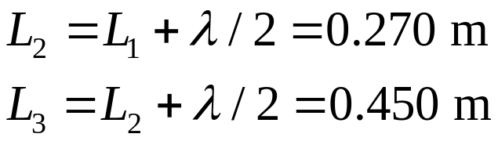
The sound waves generated by a tuning
fork are reinforced when the length
of the air column corresponds to one
of the resonant frequencies of the
tube. Suppose the smallest value of
L for which a peak occurs in the
sound intensity is 9.00 cm.
Find the frequency of the tuning fork.
(b) Find the wavelength and the next two water levels giving resonance.

